Slide 1
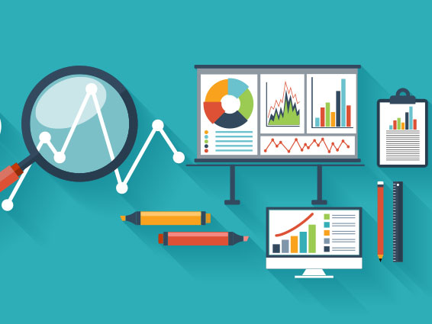
Ashish Tele Data Scientist, Advanced Analytics

Slide 2
Agenda
Why Data Visualization ?
Data Iceberg.
Ways to show results.
Choose wisely.
Which graph is right for you ?
Aesthetics : Colors
When chart hits our eyes.
What would you like to show ?

Slide 3
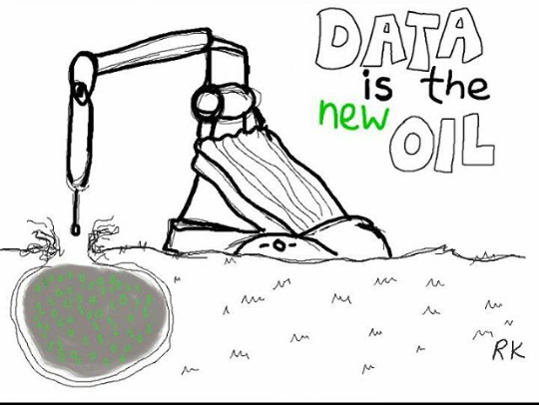
Why Data Visualization

Slide 4
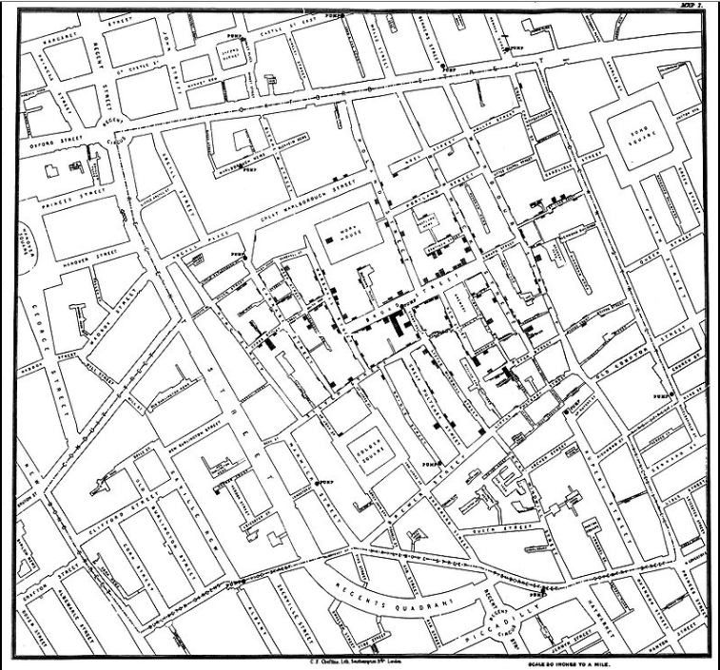
Why Data Visualization
A picture is worth 1000 words.
1854, London
Notes:
A picture can also be worth 1000 data points.
Dot distribution map
outbreak of cholera that occurred near Broad Street in the Soho district of London

Slide 5
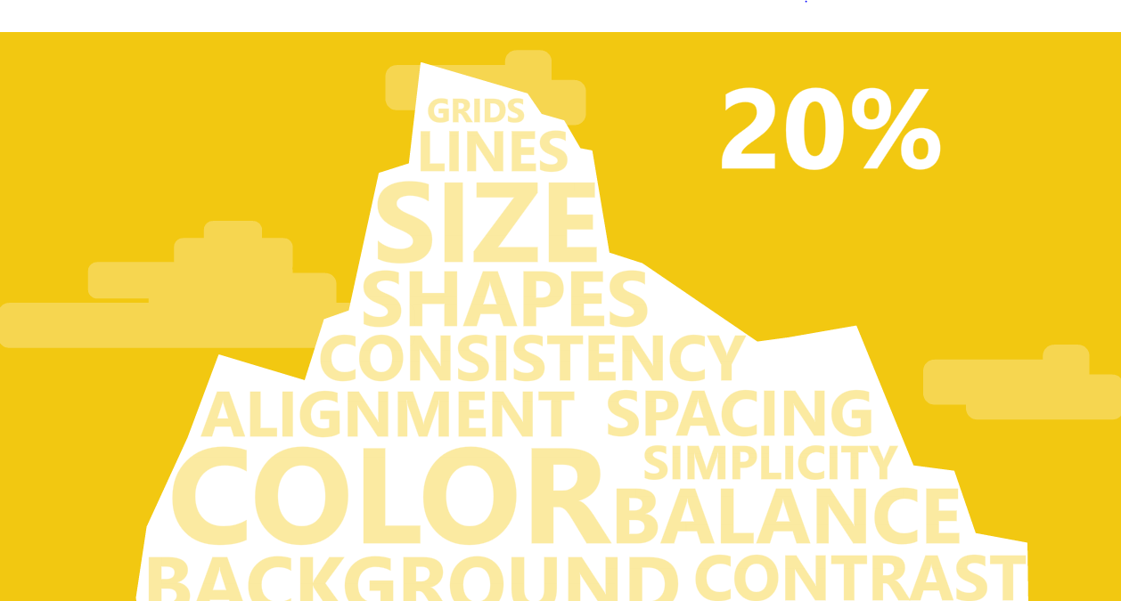

Data Iceberg
* Not Proportional
Notes:
Data visualization on reports and dashboards contributes 20% of efforts
Data cleansing

Slide 6
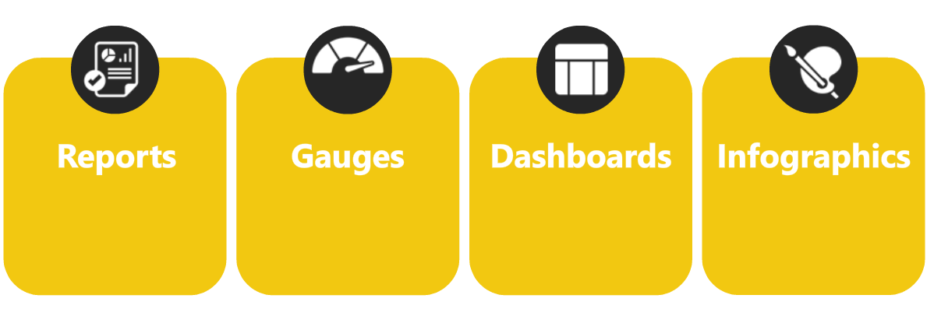
Ways to Show Results
4
Ways
to Show Results

Slide 7

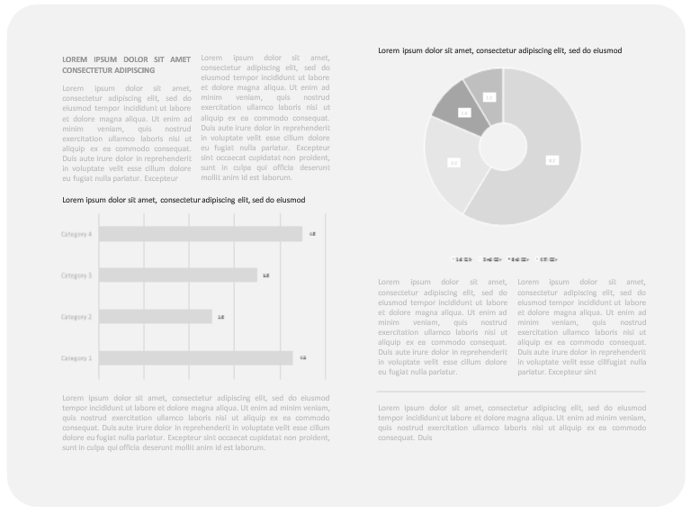
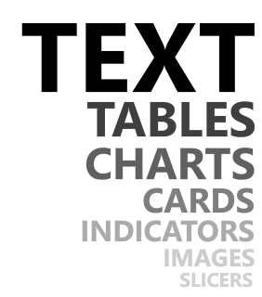
Report
Notes:
Descriptive information, text is most important, not too much images

Slide 8

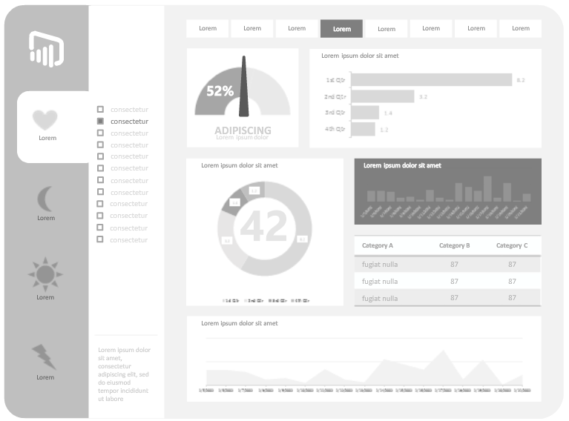
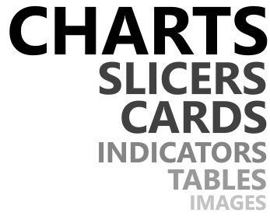
Dashboards
Notes:
Slicers are important, data filtering is part of it, relationship between the charts is important

Slide 9

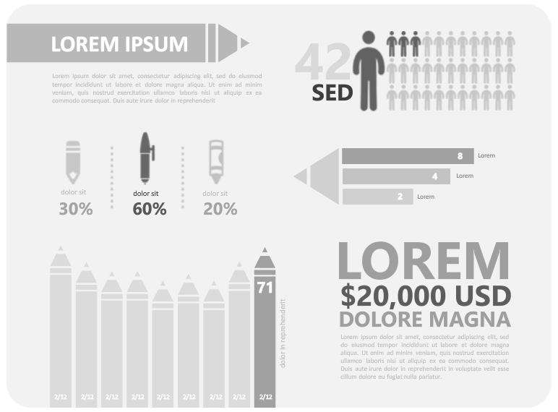
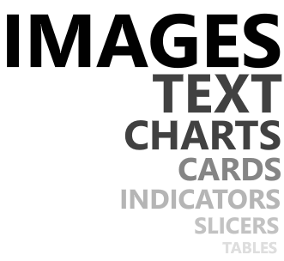
Infographics
Notes:
Less information, visualization is important

Slide 10
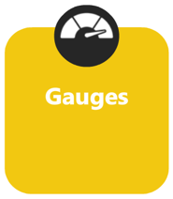
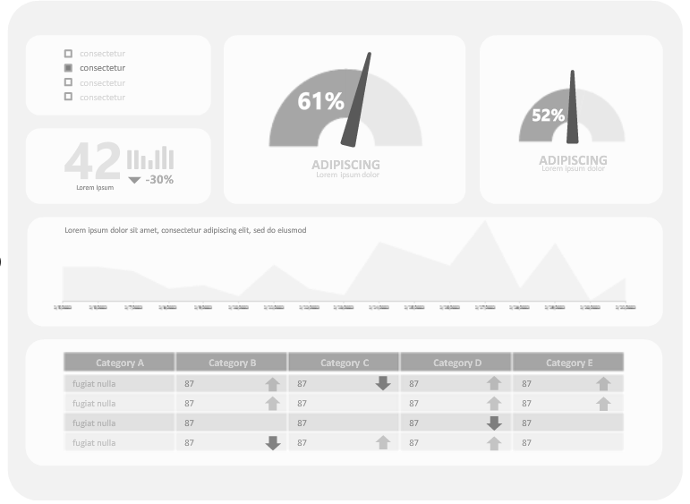
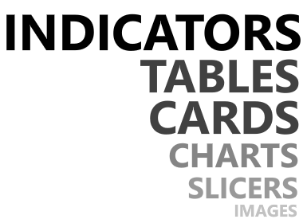
Gauges
Notes:
Want to know the information of every single moment, may be live data, Indicators are most important

Slide 11
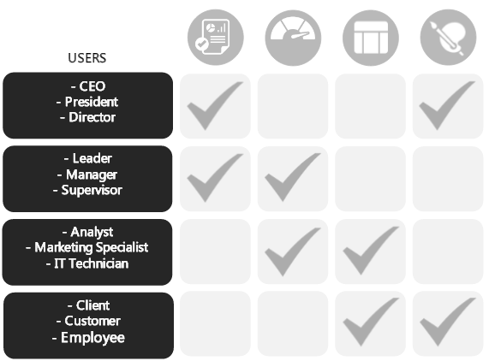
Choose Wisely
Notes:
Less information, visualization is important

Slide 12
Which graph is right for you?
Type of Visualizations:
Bar (Column)
Line
Pie
Scatter plot
Bubble Chart
Histogram
Bullet
Heat map
Others
Notes:
Less information, visualization is important

Slide 13
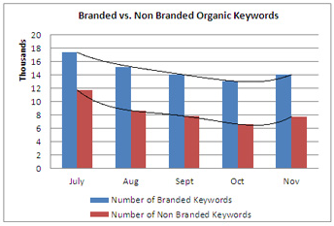
Column Chart
One of the most widely used charts.
Used to compare variables.
Categories are plotted along horizontal axis and values are plotted along the vertical axis.
Values →
Categories →
Notes:
Less information, visualization is important

Slide 14

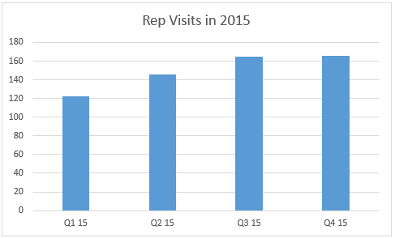

Consider Column Charts when
Two or more variables - same unit of measurement - comparable sizes
Categories < 5
Showing maximum and minimum values.
Change
Notes:
Less information, visualization is important

Slide 15
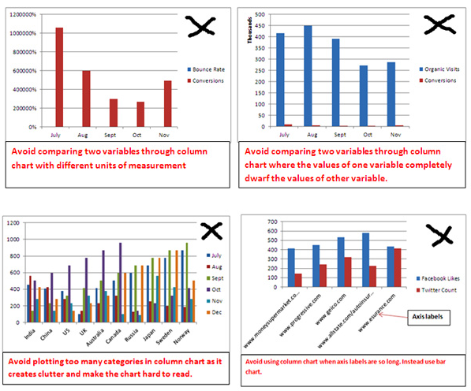

Avoid Column Charts in Scenarios like
Different Units Of Measurement
Big Difference between Units Of Measurement
Too many categories
Long Category Labels
Notes:
Less information, visualization is important

Slide 16
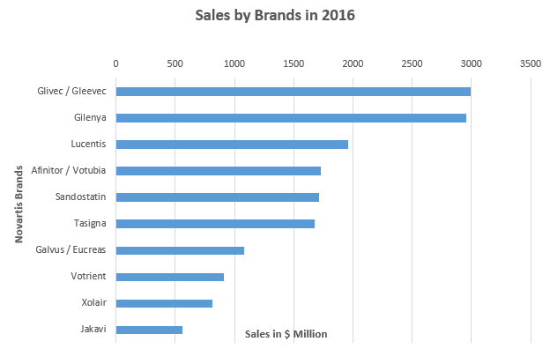
Bar Chart
Similar to column chart.
Categories are plotted along vertical axis and values are plotted along the horizontal axis.
Categories →
Values →
Notes:
Less information, visualization is important

Slide 17
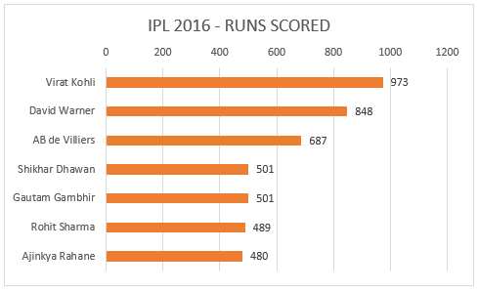
Consider Bar Charts when
Axis labels are too long to fit in a column chart.
5 < Categories < 8.
Two or more - same unit of measurement -comparable sizes.
Showing maximum and minimum values.
Change
Notes:
Less information, visualization is important

Slide 18
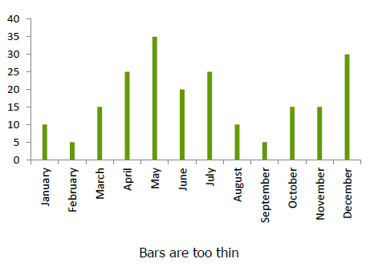
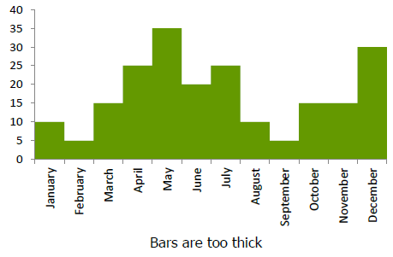
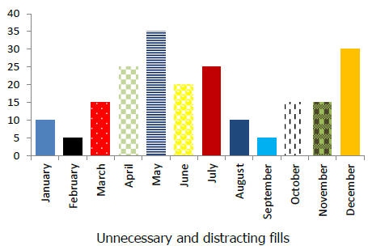
General Rules – Bar / Column Charts
Think about the bar width
Avoid using distracting fills
Notes:
If the bars are too thin, with large gaps between them, then the reader’s attention will automatically focus on the large gaps rather than the actual data.
On the other hand, if the bars are too wide—and if there is little or no gap in between them—then the data can blend into one, and become difficult to differentiate between.
In a bar chart all of the bars are usually measuring the same variable, so there is no reason why you should need to use an array of confusing colours and fills to differentiate them.

Slide 19
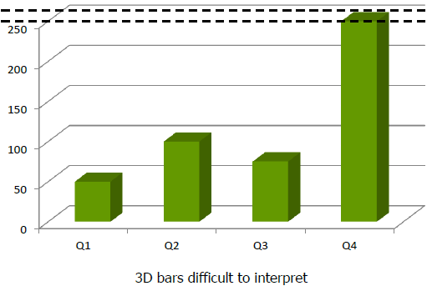
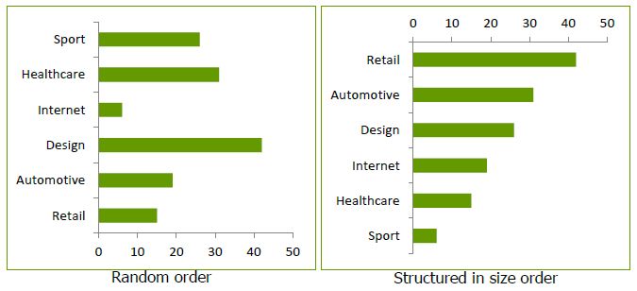
General Rules – Bar / Column Charts
Avoid using 3D bars
Where possible put the bars in size order
Notes:
The difficulty arises in determining which part of the bar is actually the ‘top’ value, and this may create confusion between users.

Slide 20
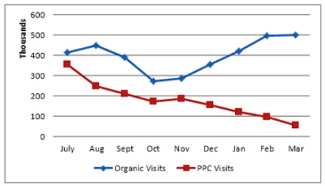
Line Chart
One of the most widely used charts.
Trends over a period of time.
TRx West
TRx East
Notes:
Less information, visualization is important

Slide 21
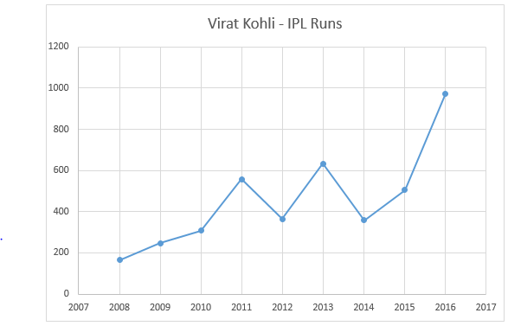
Consider Line Charts when
Showing data trends over a period of time.
Categories > 8.
Too many data points to plot.
Notes:
Less information, visualization is important

Slide 22
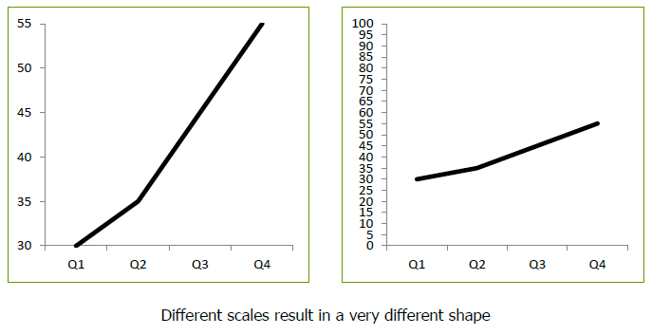
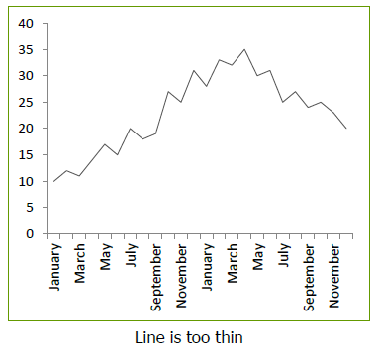
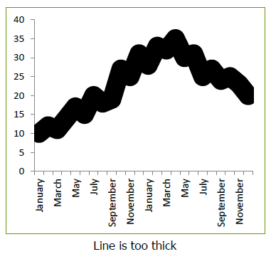
General Rules – Line Chart
Avoid misinterpreting the trend.
Think about the line thickness
Notes:
If the bars are too thin, with large gaps between them, then the reader’s attention will automatically focus on the large gaps rather than the actual data.
On the other hand, if the bars are too wide—and if there is little or no gap in between them—then the data can blend into one, and become difficult to differentiate between.
In a bar chart all of the bars are usually measuring the same variable, so there is no reason why you should need to use an array of confusing colours and fills to differentiate them.

Slide 23
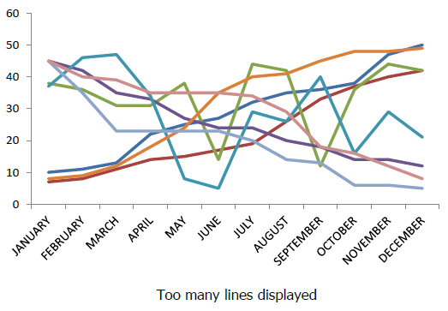
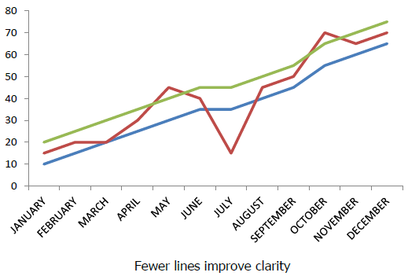
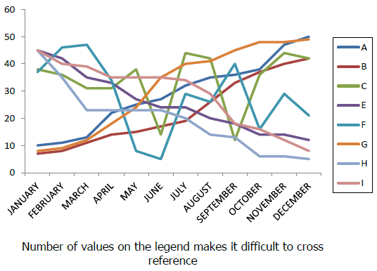
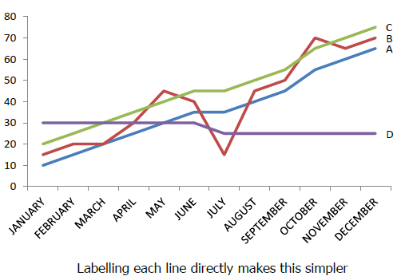
General Rules – Line Chart
Avoid too many lines together
Where possible label each line directly
Notes:
If the bars are too thin, with large gaps between them, then the reader’s attention will automatically focus on the large gaps rather than the actual data.
On the other hand, if the bars are too wide—and if there is little or no gap in between them—then the data can blend into one, and become difficult to differentiate between.
In a bar chart all of the bars are usually measuring the same variable, so there is no reason why you should need to use an array of confusing colours and fills to differentiate them.

Slide 24
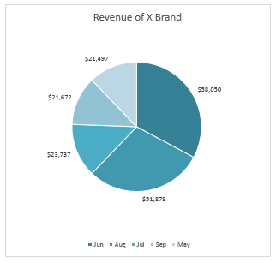
Pie Chart
Good way to show relative sizes.
Independent variable – Around a circle and Dependent variable – Arc measure
Notes:
Less information, visualization is important

Slide 25
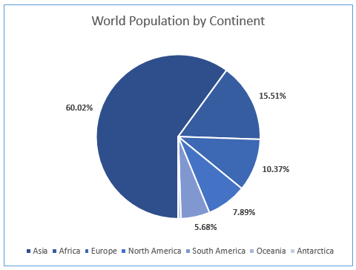
Consider Pie Charts when
Breakdown of data into its constituents.
Only one data series.
Data Points / Categories < 5.
The constituents are of comparable sizes.
Notes:
Less information, visualization is important

Slide 26
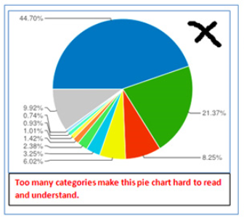
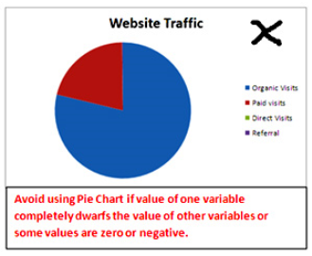



Avoid Pie Charts when
Too many categories
High Difference between values
Avoid 3D Chart
Notes:
Less information, visualization is important

Slide 27
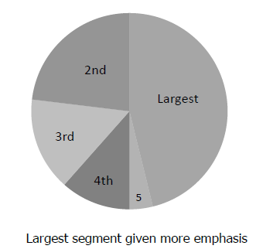
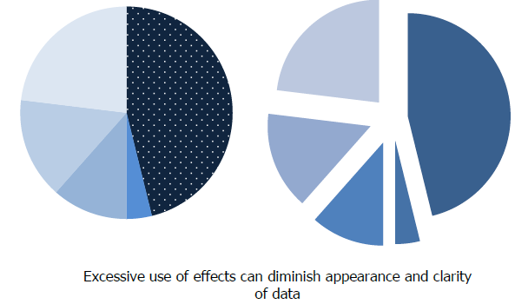
General Rules – Pie Chart
Think about the order of slices
User starts with the top of the Pie chart, so put the most important segment at top.
Don’t overuse effects to make sections stand out
Notes:
If the bars are too thin, with large gaps between them, then the reader’s attention will automatically focus on the large gaps rather than the actual data.
On the other hand, if the bars are too wide—and if there is little or no gap in between them—then the data can blend into one, and become difficult to differentiate between.
In a bar chart all of the bars are usually measuring the same variable, so there is no reason why you should need to use an array of confusing colours and fills to differentiate them.

Slide 28
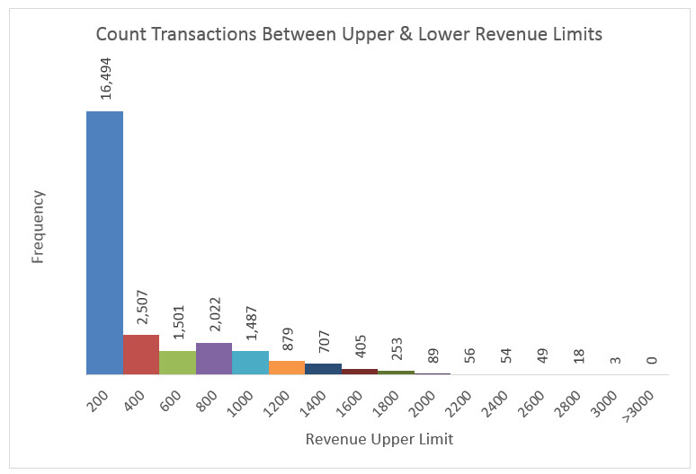
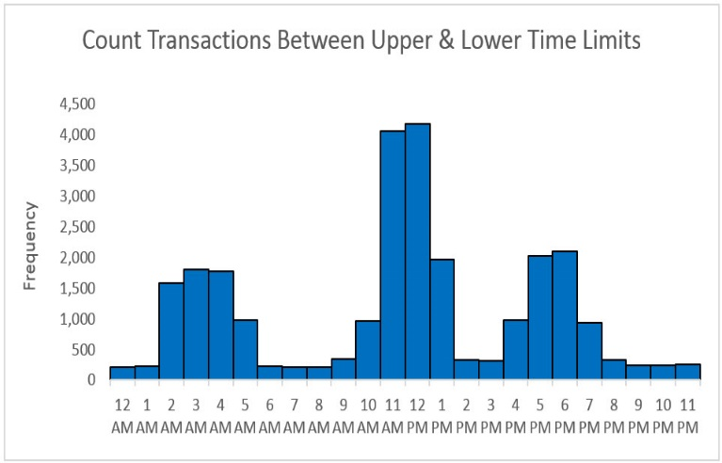
Histogram
Chart used for counting numbers between a lower and upper limit.
No gap between column indicates that there are no numbers between the upper and lower limit.
Notes:
Less information, visualization is important

Slide 29
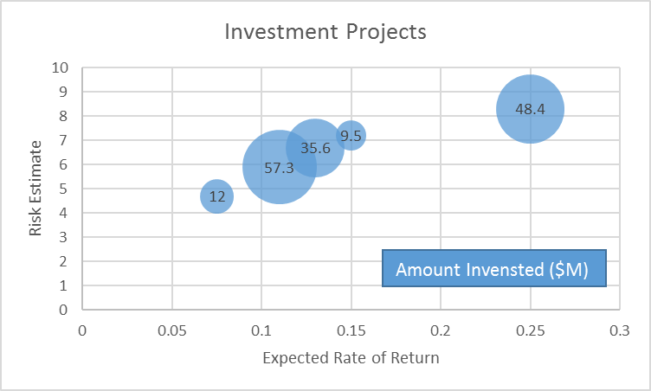
Bubble Chart
Method of visualizing 3 variables in a 2-dimensional chart.
Notes:
Less information, visualization is important

Slide 30
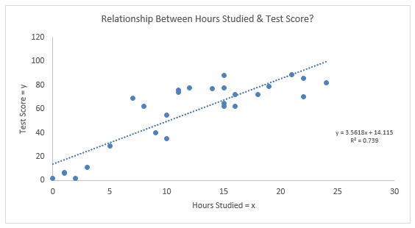
Scatter Plot
Used to show relationship between two measures ( x and y variables).
Notes:
Less information, visualization is important

Slide 31
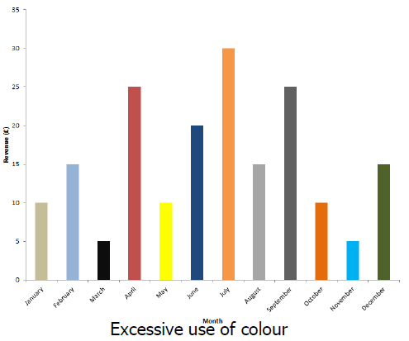
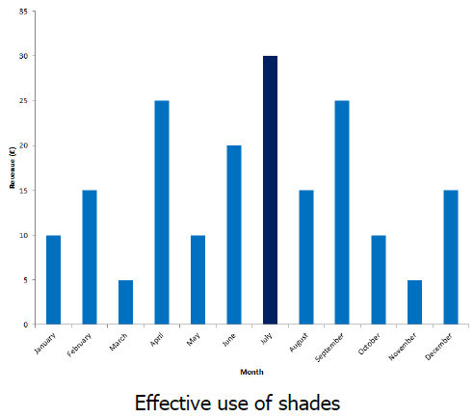
Aesthetics : Color
Don’t overuse the color.
Don’t use DIFFERENT colors for the SAME data range.
Notes:
Less information, visualization is important

Slide 32
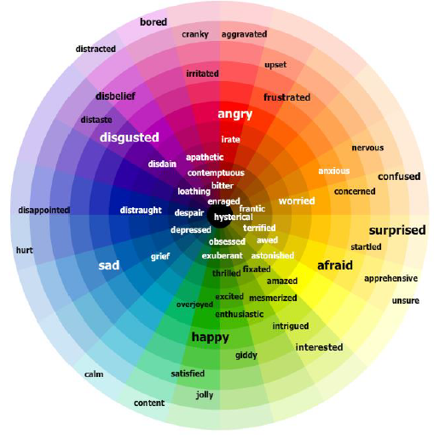
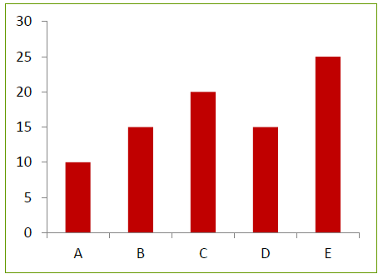

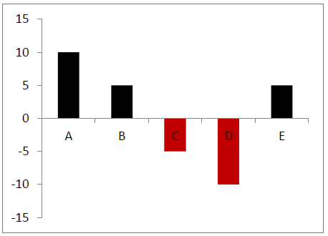

Aesthetics : Color
Don’t use SAME colors for the DIFFERENT data sets.
Consider the connotations of color.
Notes:
Less information, visualization is important

Slide 33
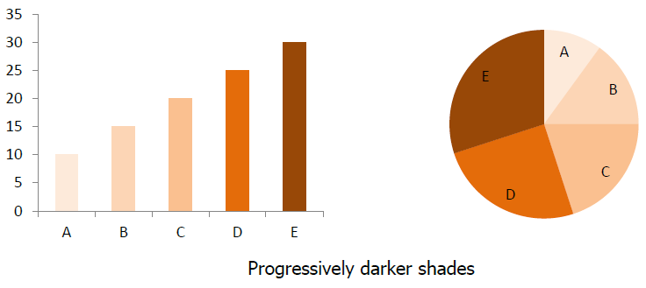


Aesthetics : Color
Choose a color scheme
Avoid the colors which are TOO close together.
Notes:
Less information, visualization is important

Slide 34


Aesthetics : Color
Avoid using gradient fills
Notes:
Less information, visualization is important

Slide 35
When a chart hits our eyes
1. We don’t go in order.
2. We see first what stands out.
3. We see only a few things at once.
4. We seek meaning and make connections.
5. We rely on conventions and metaphors.
Notes:
Less information, visualization is important

Slide 36

What would you like to show?
Notes:
Less information, visualization is important

